Slide 1

First Differences
Felipe Buchbinder

Slide 2
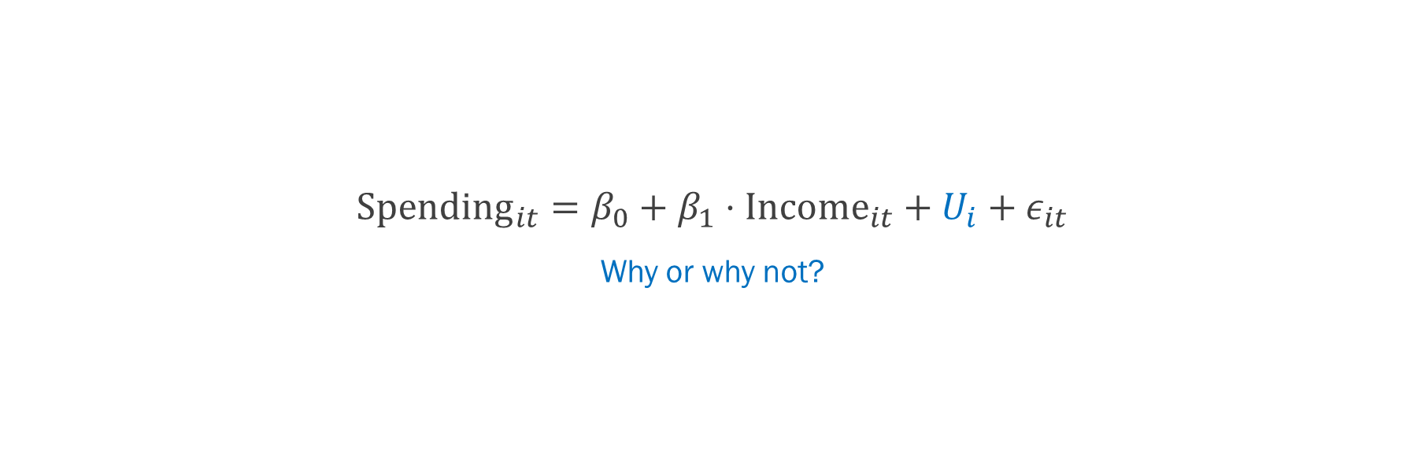
Does higher income mean higher spending? Could we use pooled regression?
$${Spending}_{it}=β_{0}+β_{1}⋅{Income}_{it}+U_{i}+ε_{it}$$
Why or why not?

Slide 3
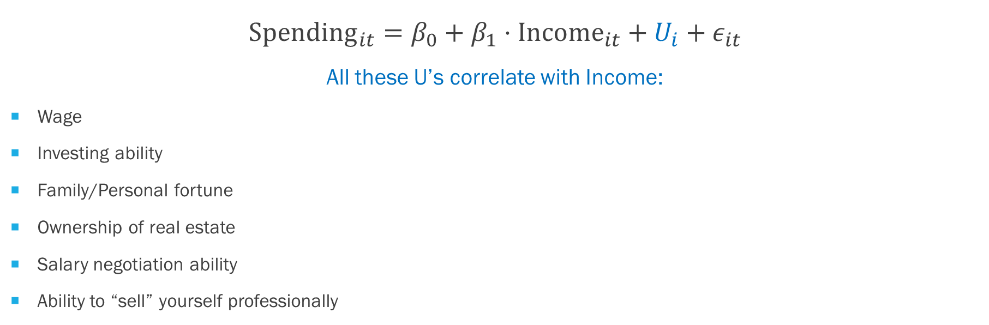
Does higher Income mean higher spending? Pooled regression is not a good idea
$${Spending}_{it}=β_{0}+β_{1}⋅{Income}_{it}+U_{i}+ε_{it}$$
All these U’s correlate with Income:
Wage
Investing ability
Family/Personal fortune
Ownership of real estate
Salary negotiation ability
Ability to “sell” yourself professionally

Slide 4
Does higher Income mean higher spending? Pooled regression is not a good idea
$${Spending}_{it}=β_{0}+β_{1}⋅{Income}_{it}+U_{i}+ε_{it}$$
All these U’s correlate with Income:
Wage
Investing ability
Family/Personal fortune
Ownership of real estate
Salary negotiation ability
Ability to “sell” yourself professionally
Flash quiz:
What would happen to the regression estimated coefficients if we did run a pooled regression?
Why did we say “all these U’s correlate with Income” rather than simply “all these U’s affect Spending”?

Slide 5
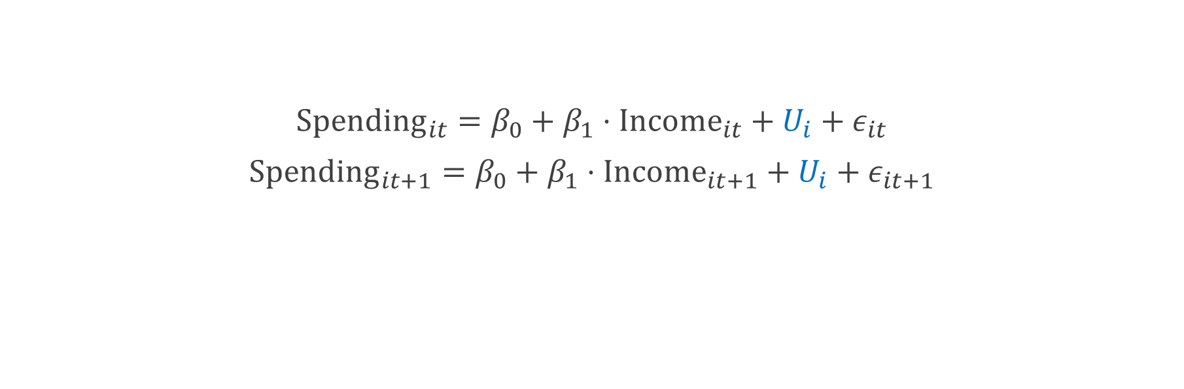
What if we looked at how changes in Income from one year to the next translate into changes in Spending?
$${Spending}_{it}=β_{0}+β_{1}⋅{Income}_{it}+U_{i}+ε_{it}$$
$${Spending}_{it+1}=β_{0}+β_{1}⋅{Income}_{it+1}+U_{i}+ε_{it+1}$$

Slide 6

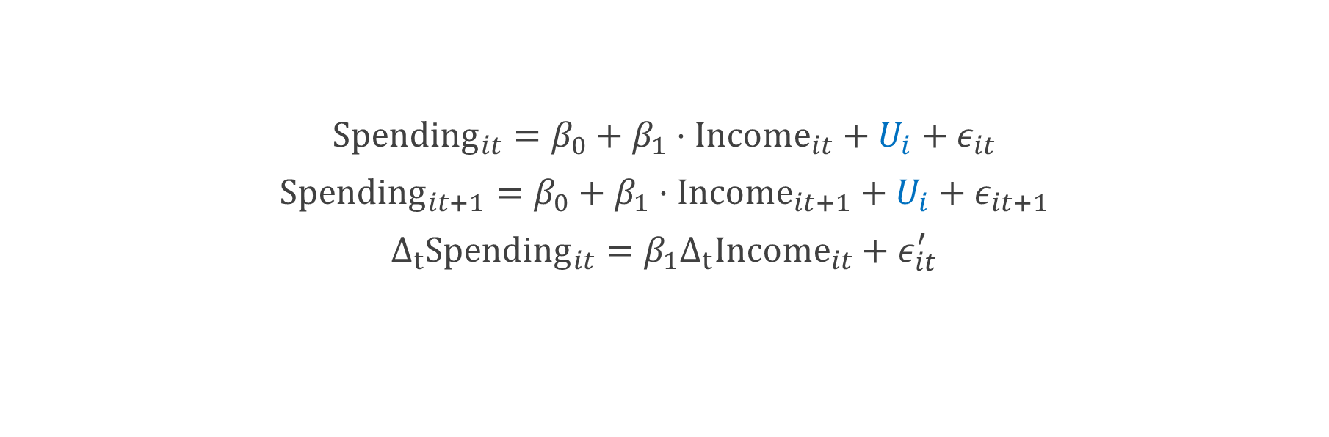
What if we looked at how changes in Income from one year to the next translate into changes in Spending?
$${Spending}_{it}=β_{0}+β_{1}⋅{Income}_{it}+U_{i}+ε_{it}$$
$${Spending}_{it+1}=β_{0}+β_{1}⋅{Income}_{it+1}+U_{i}+ε_{it+1}$$
$$Δ_{t}{Spending}_{it}=β_{1}Δ_{t}{Income}_{it}+ε_{it}^{′}$$
Since $U_{i}$ is doesn’t change from one year to the next, a difference in Spending cannot be due to $U_{i}$. It must be due to changes in Income.

Slide 7
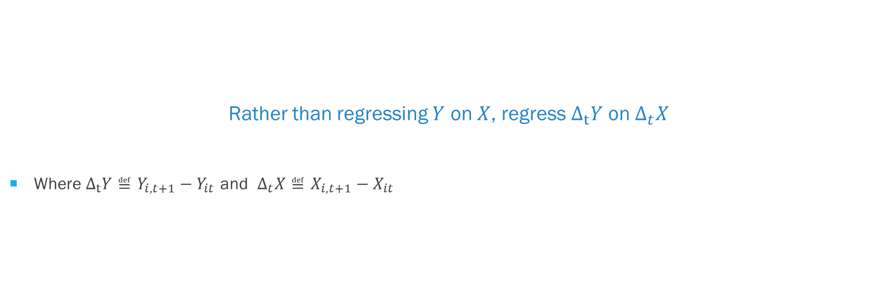
First difference model Eliminate fixed unobserved heterogeneities by focusing in how things change.
Rather than regressing $Y$ on $X$, regress $Δ_{t}Y$ on $Δ_{t}X$
Where $Δ_{t}Y≝Y_{i,t+1}−Y_{it}$ and $Δ_{t}X≝X_{i,t+1}−X_{it}$

Slide 8
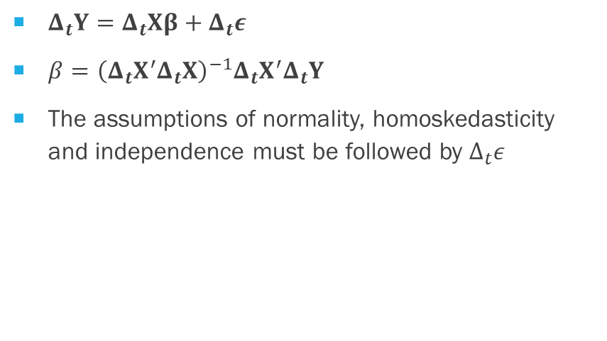
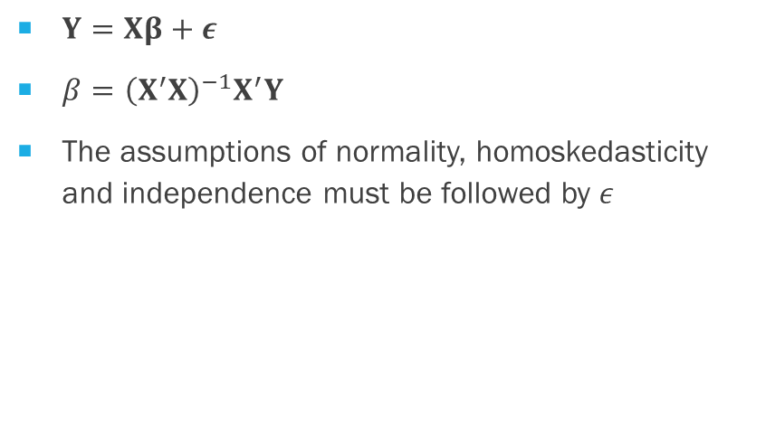
A First differences model works just like OLS regression but with changes instead of actual values
OLS Regression
First Differences Regression
$Y=Xβ+ε$
$β={\left(X^{′}X\right)}^{−1}X^{′}Y$
The assumptions of normality, homoskedasticity and independence must be followed by $ε$
$Δ_{t}Y=Δ_{t}Xβ+Δ_{t}ε$
$β={\left(Δ_{t}X^{′}Δ_{t}X\right)}^{−1}Δ_{t}X^{′}Δ_{t}Y$
The assumptions of normality, homoskedasticity and independence must be followed by $Δ_{t}ε$

Slide 9
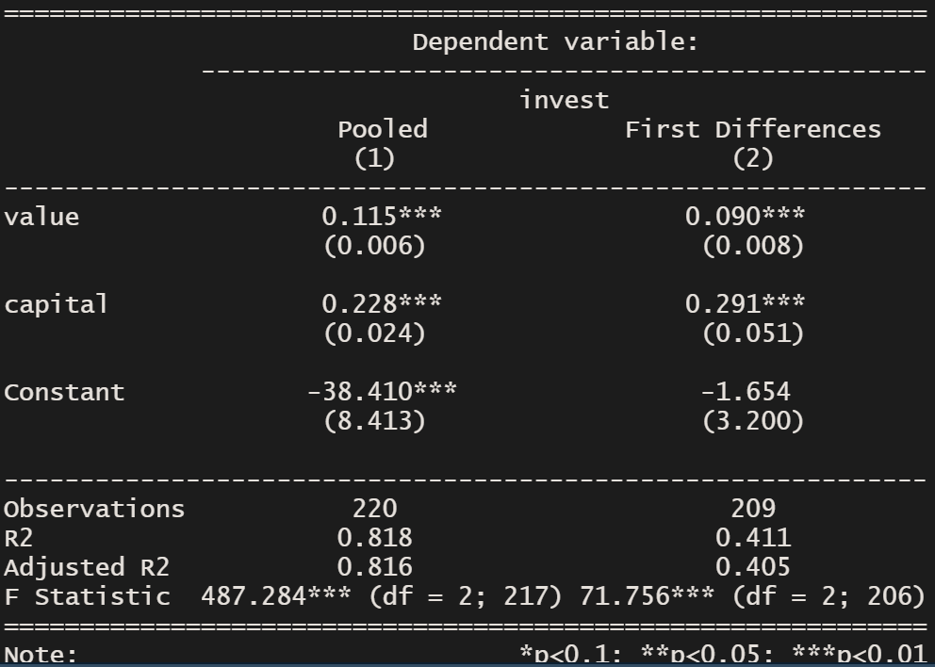
Is investment determined by company value? The Grunfeld dataset
#Pooled regression
pooled <- plm(invest ~ value + capital, index=c(“firm”, “year”), data=Grunfeld, model='pooling’)
#First Differences model
fd <- plm(invest ~ value + capital, index=c(“firm”, “year”), data=Grunfeld, model=‘fd’)

Slide 10
Is investment determined by company value? The Grunfeld dataset
#Pooled regression
pooled <- plm(invest ~ value + capital, index=c(“firm”, “year”), data=Grunfeld, model='pooling’)
#First Differences model
fd <- plm(invest ~ value + capital, index=c(“firm”, “year”), data=Grunfeld, model=‘fd’)
Why do we have less observations in FD than in PR?

Slide 11
Is investment determined by company value? The Grunfeld dataset
#Pooled regression
pooled <- plm(invest ~ value + capital, index=c(“firm”, “year”), data=Grunfeld, model='pooling’)
#First Differences model
fd <- plm(invest ~ value + capital, index=c(“firm”, “year”), data=Grunfeld, model=‘fd’)
Why are the coefficient’s standard errors larger in FD than in PR?

Slide 12

A trick First differences regression can’t do:

Slide 13

Account for things that do not change in time (why?)

Slide 14

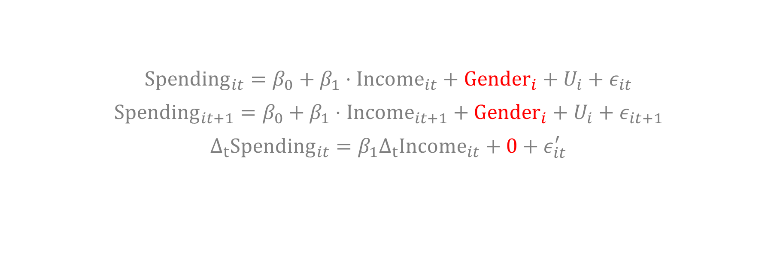
First difference models cannot account for time-invariant covariates
$${Spending}_{it}=β_{0}+β_{1}⋅{Income}_{it}+{Gender}_{i}+U_{i}+ε_{it}$$
$${Spending}_{it+1}=β_{0}+β_{1}⋅{Income}_{it+1}+{Gender}_{i}+U_{i}+ε_{it+1}$$
$$Δ_{t}{Spending}_{it}=β_{1}Δ_{t}{Income}_{it}+0+ε_{it}^{′}$$
Since ${Gender}_{i}$ doesn’t change from one year to the next, it cancels out when we calculate $Δ_{t}{Spending}_{it}$.
As a result, we cannot estimate the effect that Gender has on Spending.

Slide 15


First differences regression requires the $Δ_{t}ε_{it}$ to be serially uncorrelated (Why?)

Slide 16

this does not happen if the errors themselves are serially uncorrelated

Slide 17

If errors are uncorrelated in the true relationship, then a First Differences model does not satisfy the assumption of serially uncorrelated residuals. The First Difference model is not a good model when the errors in the true relationship are serially uncorrelated.

Slide 18
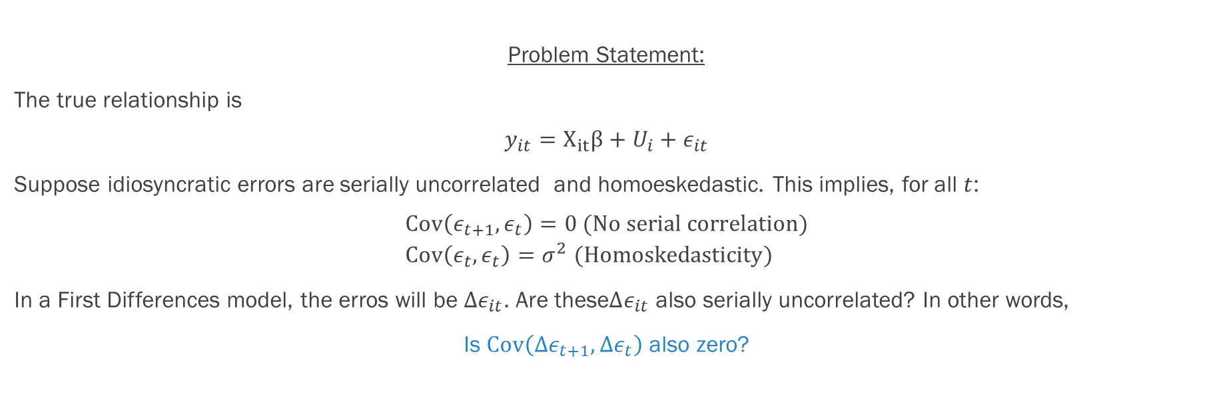
Proof
Problem Statement:
The true relationship is
$$y_{it}=X_{it}β+U_{i}+ε_{it}$$
Suppose idiosyncratic errors are serially uncorrelated and homoeskedastic. This implies, for all $t$:
$$Cov\left(ε_{t+1},ε_{t}\right)=0 (No serial correlation) \\ Cov\left(ε_{t},ε_{t}\right)=σ^{2} (Homoskedasticity)$$
In a First Differences model, the erros will be $Δε_{it}$. Are these$Δε_{it}$ also serially uncorrelated? In other words,
Is $Cov\left(Δε_{t+1},{Δε}_{t}\right)$ also zero?

Slide 19
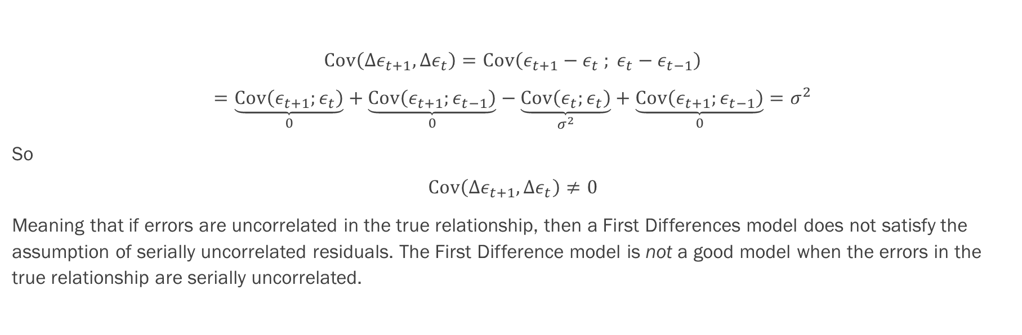
Proof
$$Cov\left(Δε_{t+1},{Δε}_{t}\right)=Cov\left(ε_{t+1}−ε_{t} ; ε_{t}−ε_{t−1}\right)$$
$$=\underset{0}{\underbrace{Cov\left(ε_{t+1};ε_{t}\right)}}+\underset{0}{\underbrace{Cov\left(ε_{t+1};ε_{t−1}\right)}}−\underset{σ^{2}}{\underbrace{Cov\left(ε_{t};ε_{t}\right)}}+\underset{0}{\underbrace{Cov\left(ε_{t+1};ε_{t−1}\right)}}=σ^{2}$$
So
$$Cov\left(Δε_{t+1},{Δε}_{t}\right)≠0$$
Meaning that if errors are uncorrelated in the true relationship, then a First Differences model does not satisfy the assumption of serially uncorrelated residuals. The First Difference model is not a good model when the errors in the true relationship are serially uncorrelated.

Slide 20
If errors are uncorrelated in the true relationship, then a First Differences model does not satisfy the assumption of serially uncorrelated residuals. The First Difference model is not a good model when the errors in the true relationship are serially uncorrelated.
The First Difference model works well when errors in the true relationship obey a random walk.

Slide 21


Errors are said to follow a random walk when $$ε_{t+1}=ε_{t}+ν_{t} \\ ν_{t}\sim N\left(0;σ^{2}\right) \\ Cov\left(ν_{t};ν_{s}\right)=0 ∀ t≠s$$

Slide 22
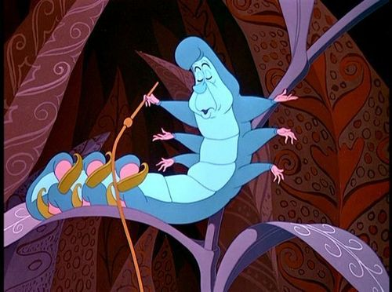

This works because…
$$ε_{t+1}=ε_{t}+ν_{t} \\ ⇓ \\ Δ_{t}ε_{t}=ν_{t}$$
Which are homoscedastic and serially uncorrelated by hypothesis, thus satisfying the requirements of OLS regression.

Slide 23

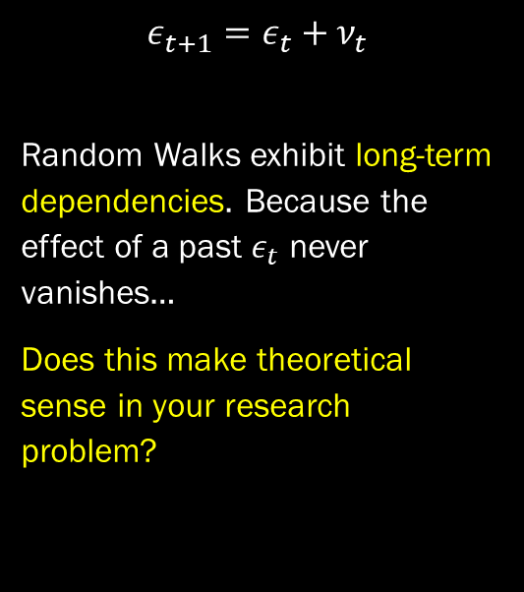
One thing you should know before taking a random walk…
$$ε_{t+1}=ε_{t}+ν_{t}$$
Random Walks exhibit long-term dependencies. Because the effect of a past $ε_{t}$ never vanishes…
Does this make theoretical sense in your research problem?

Slide 24

How do we know if residuals follow a random walk, and a first difference model is therefore adequate?

Slide 25
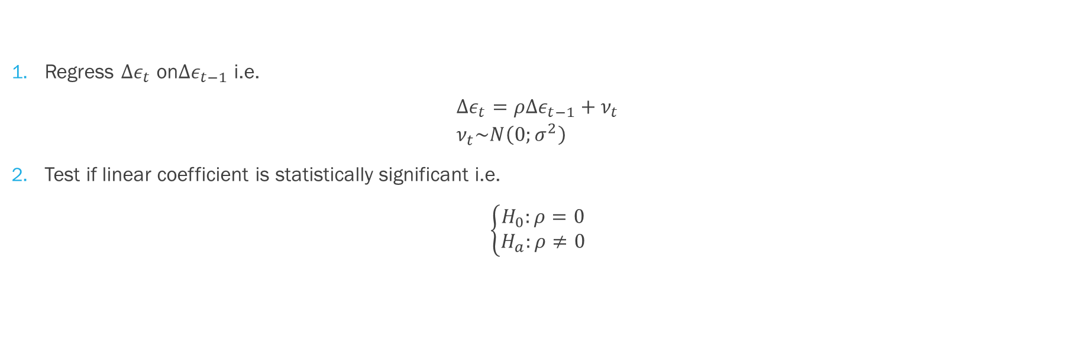
How do we know if errors follow a random walk? Intuition
Regress $Δε_{t}$ on$Δε_{t−1}$ i.e.
$$Δε_{t}=ρΔε_{t−1}+ν_{t} \\ ν_{t}\sim N\left(0;σ^{2}\right)$$
Test if linear coefficient is statistically significant i.e.
$$\left\{\begin{aligned}H_{0}:ρ=0 \\ H_{a}:ρ≠0\end{aligned}\right.$$

Slide 26
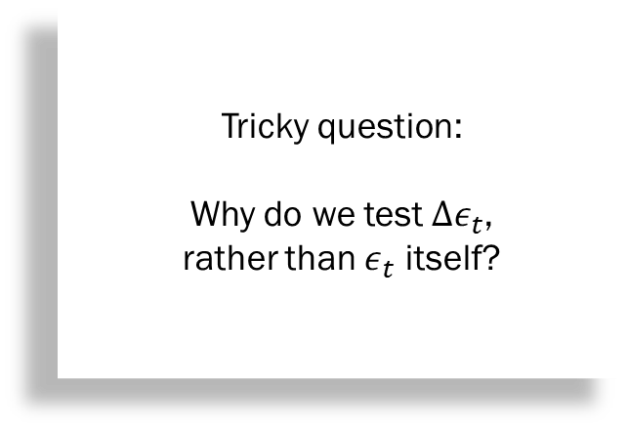
How do we know if errors follow a random walk? Intuition
Regress $Δε_{t}$ on$Δε_{t−1}$ i.e.
$$Δε_{t}=ρΔε_{t−1}+ν_{t} \\ ν_{t}\sim N\left(0;σ^{2}\right)$$
Test if linear coefficient is statistically significant i.e.
$$\left\{\begin{aligned}H_{0}:ρ=0 \\ H_{a}:ρ≠0\end{aligned}\right.$$
Tricky question:
Why do we test $Δε_{t}$,
rather than $ε_{t}$ itself?

Slide 27
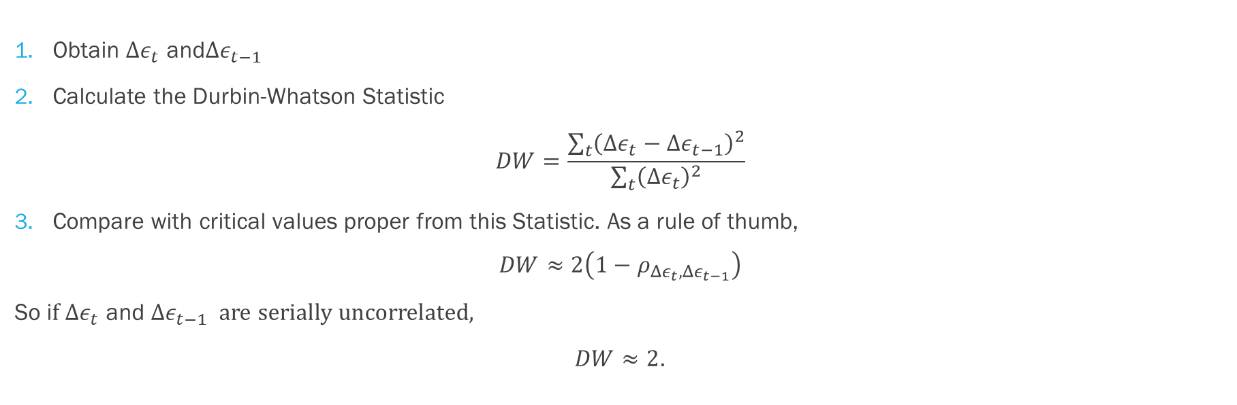
How do we know if errors follow a random walk? The Durbin-Whatson Statistic
Obtain $Δε_{t}$ and$Δε_{t−1}$
Calculate the Durbin-Whatson Statistic
$$DW=\frac{\sum_{t}{{\left(Δε_{t}−Δε_{t−1}\right)}^{2}}}{\sum_{t}{{\left(Δε_{t}\right)}^{2}}}$$
Compare with critical values proper from this Statistic. As a rule of thumb,
$$DW≈2\left(1−ρ_{Δε_{t},Δε_{t−1}}\right)$$
So i$f Δε_{t} \text{and} Δε_{t−1}$ are serially uncorrelated,
$DW≈2$.

Slide 28

How do we know if errors follow a random walk? The Durbin-Whatson Statistic
Obtain $Δε_{t}$ and$Δε_{t−1}$
Calculare the Durbin-Whatson Statistic
$$DW=\frac{\sum_{t}{{\left(Δε_{t}−Δε_{t−1}\right)}^{2}}}{\sum_{t}{{\left(Δε_{t}\right)}^{2}}}$$
Compare with critical values proper from this Statistic. As a rule of thumb,
$$DW≈2\left(1−ρ_{Δε_{t},Δε_{t−1}}\right)$$
So i$f Δε_{t} \text{and} Δε_{t−1}$ are serially uncorrelated,
$DW≈2$.
Flash quiz:
What are the maximum and minimum values for the DW statistic?

Slide 29

How do we know if errors follow a random walk? The Durbin-Whatson Statistic
Obtain $Δε_{t}$ and$Δε_{t−1}$
Calculare the Durbin-Whatson Statistic
$$DW=\frac{\sum_{t}{{\left(Δε_{t}−Δε_{t−1}\right)}^{2}}}{\sum_{t}{{\left(Δε_{t}\right)}^{2}}}$$
Compare with critical values proper from this Statistic. As a rule of thumb,
$$DW≈2\left(1−ρ_{Δε_{t},Δε_{t−1}}\right)$$
So i$f Δε_{t} \text{and} Δε_{t−1}$ are serially uncorrelated,
$DW≈2$.
Flash quiz:
A rule of thumb says that $DW<1$ means trouble.
To what value of $ρ$ does this correspond?

Slide 30
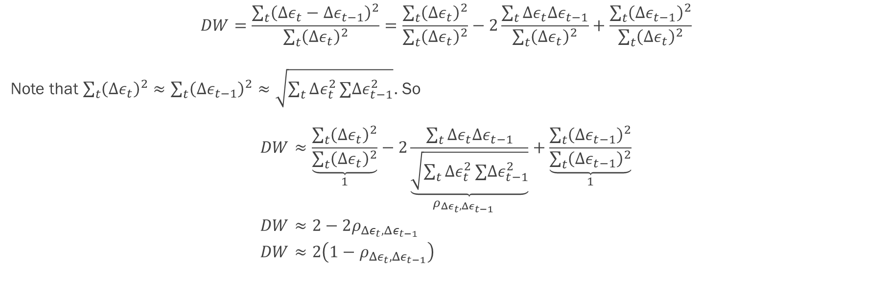

Proof that $D≈2\left(1−ρ_{Δε_{t},Δε_{t−1}}\right)$
$$DW=\frac{\sum_{t}{{\left(Δε_{t}−Δε_{t−1}\right)}^{2}}}{\sum_{t}{{\left(Δε_{t}\right)}^{2}}}=\frac{\sum_{t}{{\left(Δε_{t}\right)}^{2}}}{\sum_{t}{{\left(Δε_{t}\right)}^{2}}}−2\frac{\sum_{t}{Δε_{t}Δε_{t−1}}}{\sum_{t}{{\left(Δε_{t}\right)}^{2}}}+\frac{\sum_{t}{{\left(Δε_{t−1}\right)}^{2}}}{\sum_{t}{{\left(Δε_{t}\right)}^{2}}}$$
Note that $\sum_{t}{{\left(Δε_{t}\right)}^{2}}≈\sum_{t}{{\left(Δε_{t−1}\right)}^{2}}≈\sqrt{\sum_{t}{Δε_{t}^{2}}∑Δε_{t−1}^{2}}$. So
$$DW≈\underset{1}{\underbrace{\frac{\sum_{t}{{\left(Δε_{t}\right)}^{2}}}{\sum_{t}{{\left(Δε_{t}\right)}^{2}}}}}−\underset{ρ_{Δε_{t},Δε_{t−1}}}{2\underbrace{\frac{\sum_{t}{Δε_{t}Δε_{t−1}}}{\sqrt{\sum_{t}{Δε_{t}^{2}}∑Δε_{t−1}^{2}}}}}+\underset{1}{\underbrace{\frac{\sum_{t}{{\left(Δε_{t−1}\right)}^{2}}}{\sum_{t}{{\left(Δε_{t−1}\right)}^{2}}}}} \\ DW≈2−2ρ_{Δε_{t},Δε_{t−1}} \\ DW≈2\left(1−ρ_{Δε_{t},Δε_{t−1}}\right)$$

Slide 31

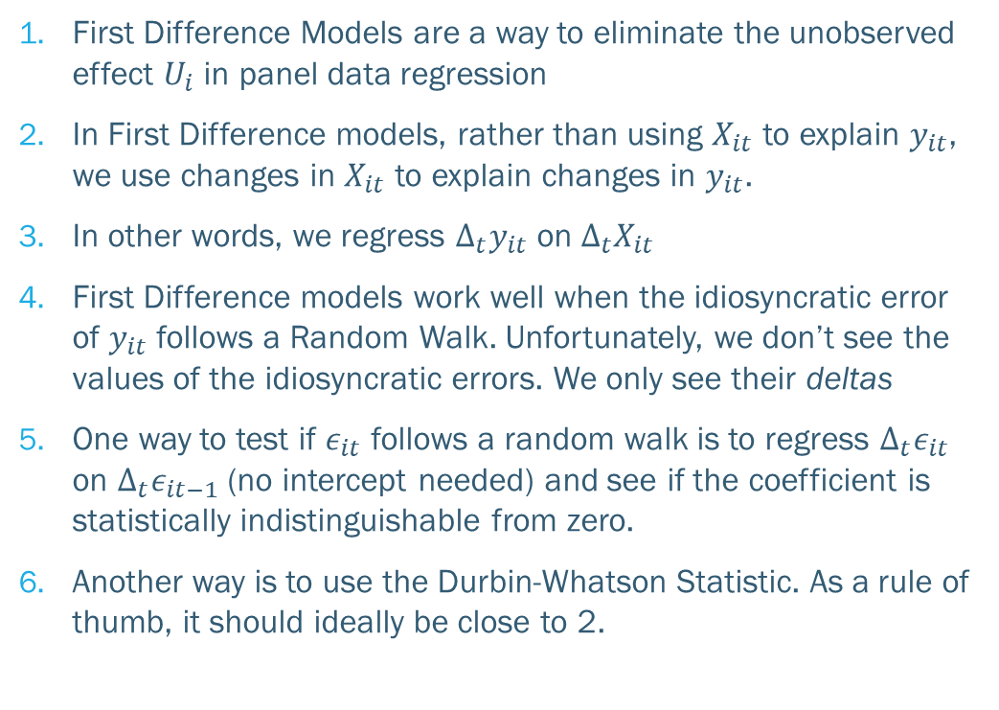
Key takeaways
First Difference Models are a way to eliminate the unobserved effect $U_{i}$ in panel data regression
In First Difference models, rather than using $X_{it}$ to explain $y_{it}$, we use changes in $X_{it}$ to explain changes in $y_{it}$.
In other words, we regress $Δ_{t}y_{it}$ on $Δ_{t}X_{it}$
First Difference models work well when the idiosyncratic error of $y_{it}$ follows a Random Walk. Unfortunately, we don’t see the values of the idiosyncratic errors. We only see their deltas
One way to test if $ε_{it}$ follows a random walk is to regress $Δ_{t}ε_{it}$ on $Δ_{t}ε_{it−1}$ (no intercept needed) and see if the coefficient is statistically indistinguishable from zero.
Another way is to use the Durbin-Whatson Statistic. As a rule of thumb, it should ideally be close to 2.

